Slide 1
NPS Dashboard and data update manual

Slide 2
Outline
Dashboard operation
How to update data
Publish Dashboard

Slide 3
Dashboard operation

Slide 4
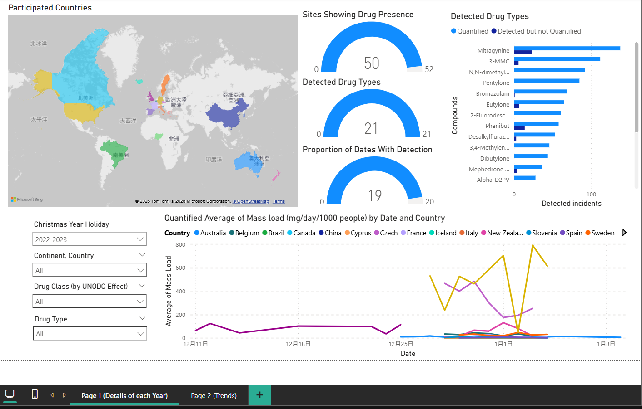
Dashboard Interface (Page 1)

Slide 5
Dashboard Interface (Page 1)
Participated Countries
Showing the countries which provided the wastewater samples for NPS analyze in each year

Slide 6
Dashboard Interface (Page 1)
Data Slicer
Filter the data of interest based on:
Christmas Year holiday (Single selection only)
Continent & Country
Drug Class by UNDOC Effect
Drug type in alphabet order

Slide 7
Dashboard Interface (Page 1)
Gauge Indicator
Showing the proportion of:
Sites with drug presence
Detected drug types
Dates with drug presence over the sampling period

Slide 8
Dashboard Interface (Page 1)
Detected drug types bar chart
Showing detected incidents of each drug, including quantified or detected but not quantified

Slide 9
Dashboard Interface (Page 1)
Time series of mass load (single year)
Showing the quantified average of drug mass load of each country

Slide 10
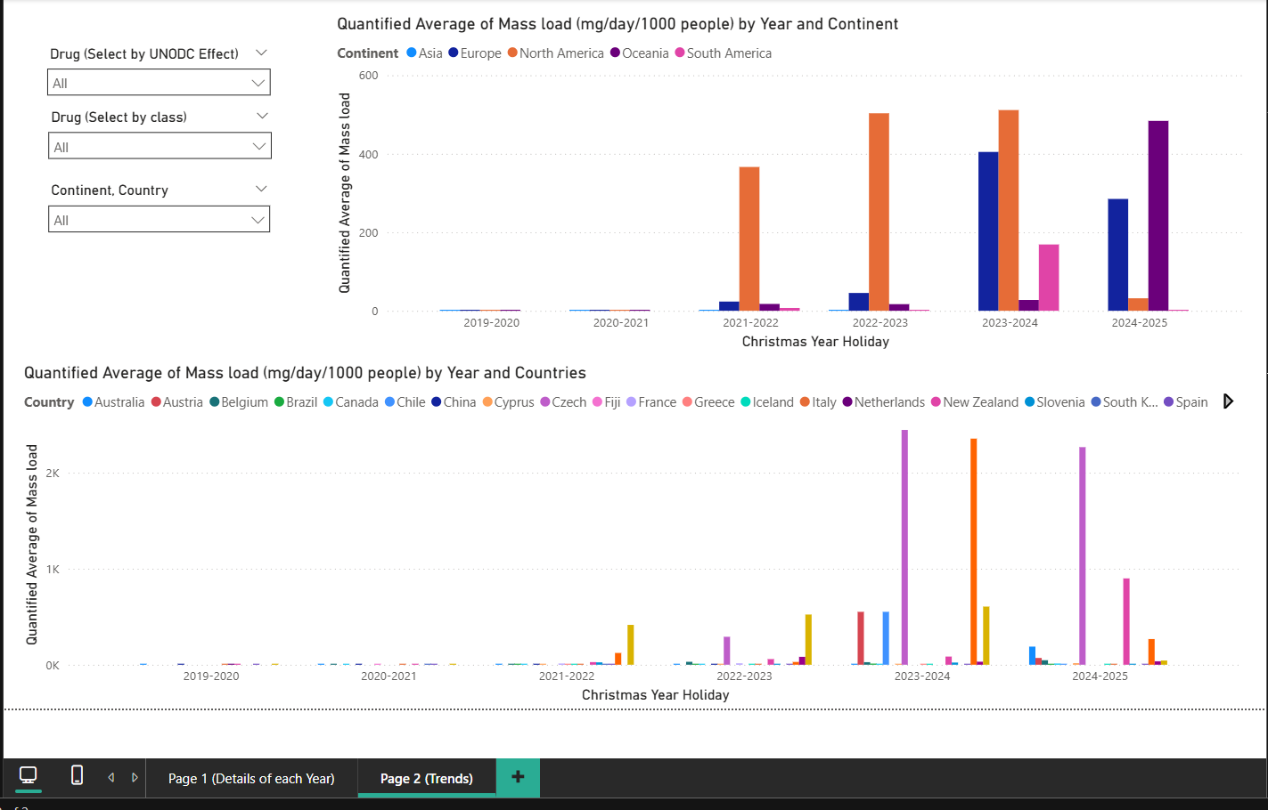
Dashboard Interface (Page 2)

Slide 11
Dashboard Interface (Page 2)
Time series of mass load (multiple years)
Showing the quantified average of drug mass load of each country or continent based on data slicer

Slide 12
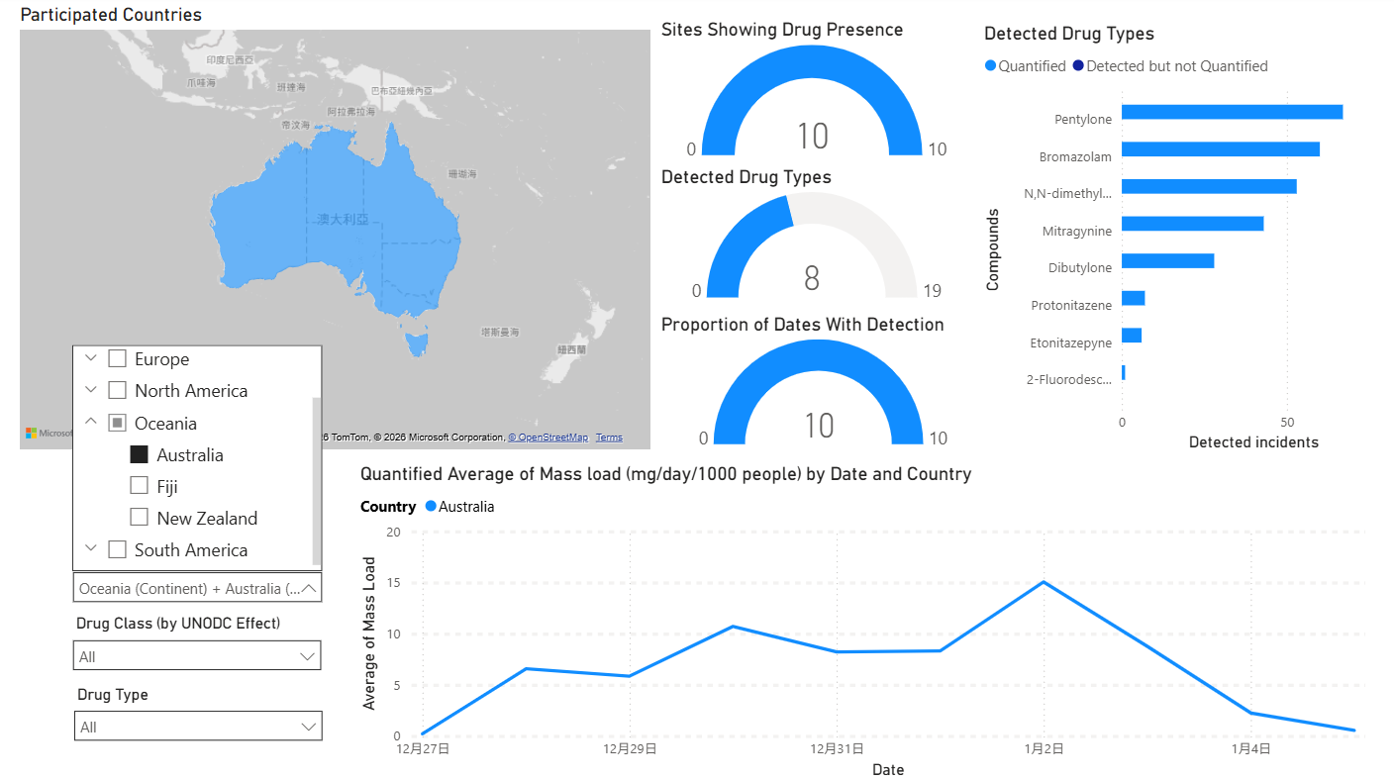
Methods to select specific country
Method 1 -- Select by data slicer
Map zoom into the selected country
Line chart and bar char display the selected country only
Gauge indicators automatically display the selected country
Most recommended method

Slide 13
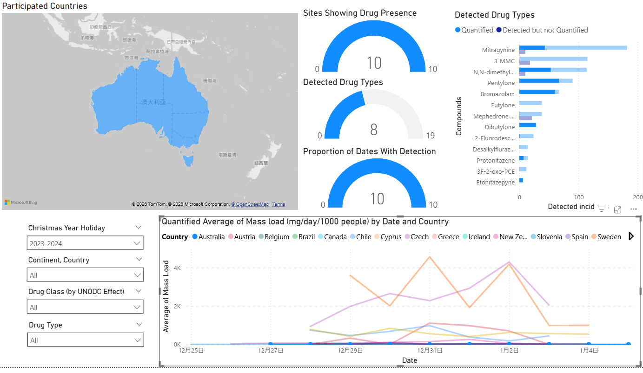
Methods to select specific country
Method 2 -- Select by clicking legend in line chart
Map zoom into the selected country
Line chart highlight the selected line
Gauge indicators automatically display the selected country
Bar chart highlight the proportion
Remember to click it back or it will cause conflict with data slicer !!

Slide 14
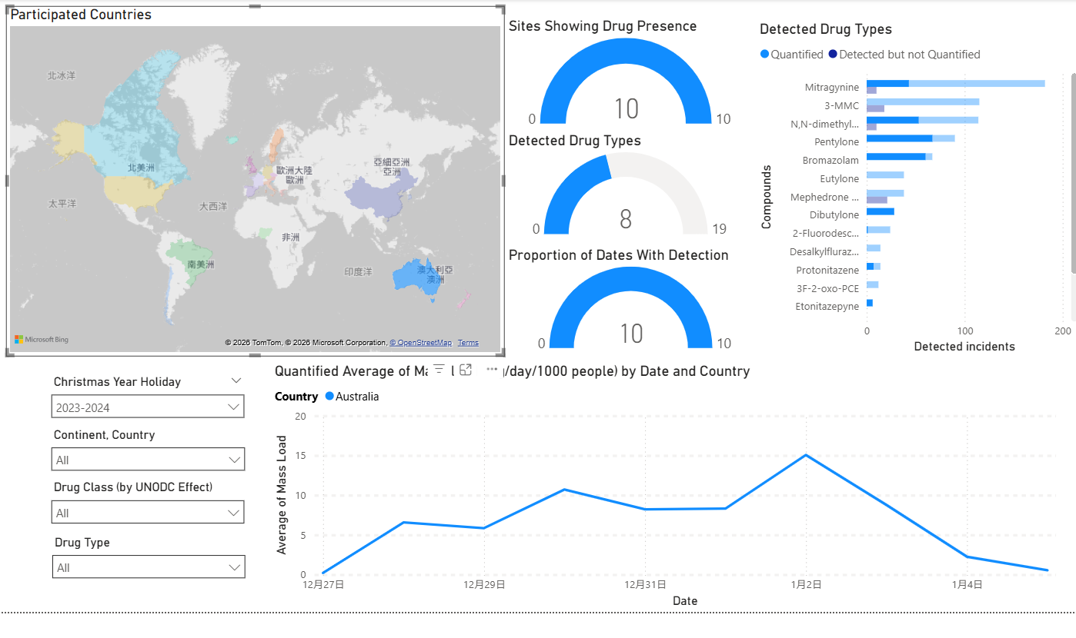
Methods to select specific country
Method 3 -- Select by clicking country on the map
Line chart and display the selected country only
Bar chart highlight the proportion
Gauge indicators automatically display the selected country
Remember to click it back or it will cause conflict with data slicer !!

Slide 15
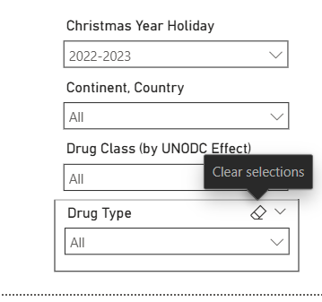
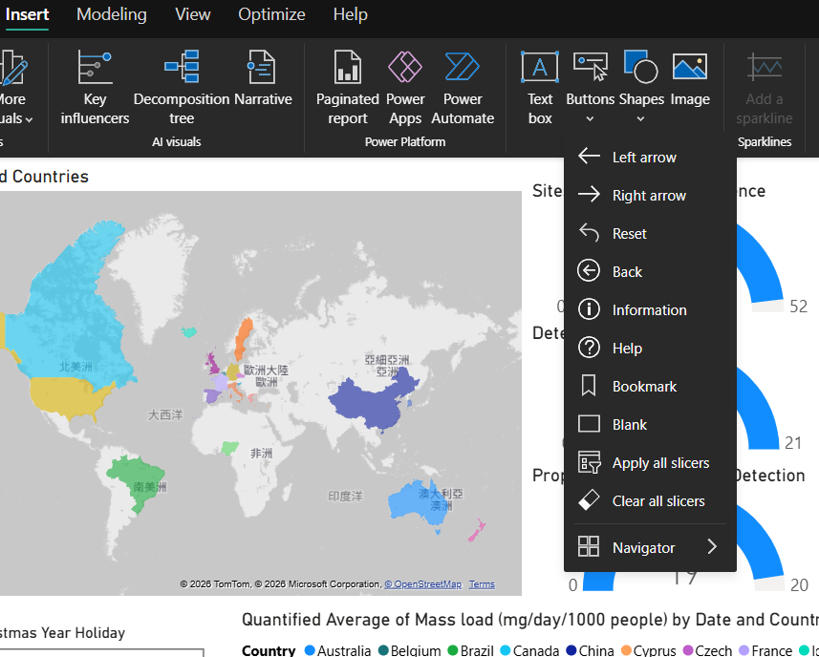
Clear Selection
Method 1 click the icon on data slicer
Method 2 Apply the Clear all slicer button onto the dashboard

Slide 16
How to update data

Slide 17
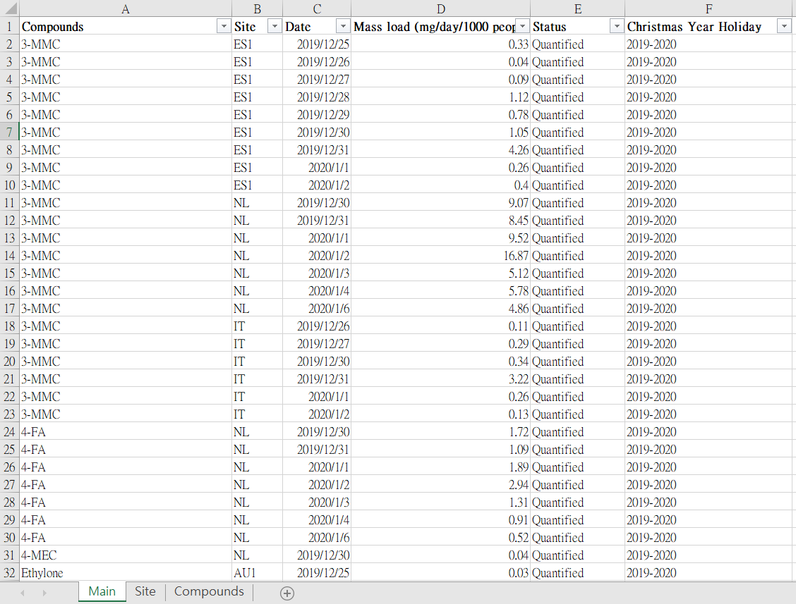
Data Spreadsheet (Main)
Containing the following attributes
Compounds: Analyzed drug type
Site: sampling site
Date: the sampling date
Mass load: unit (mg/day/1000 people) Remember to apply 0 if status is Detected but not quantified or Not detected
Status: either Quantified/ Detected but not quantified/ Not detected
Christmas Year Holiday

Slide 18
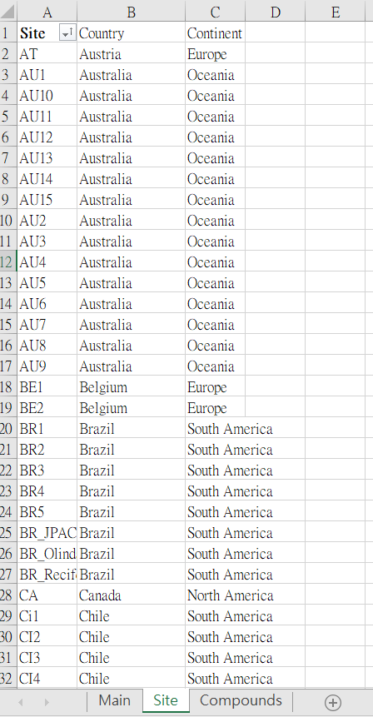
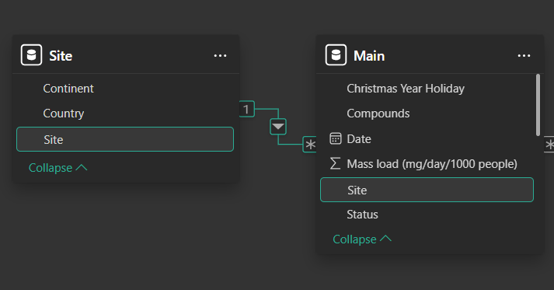
Data Spreadsheet (Site)
Containing the Country and continent information of the sites in main sheet
Linked to the site attribute in main sheet

Slide 19
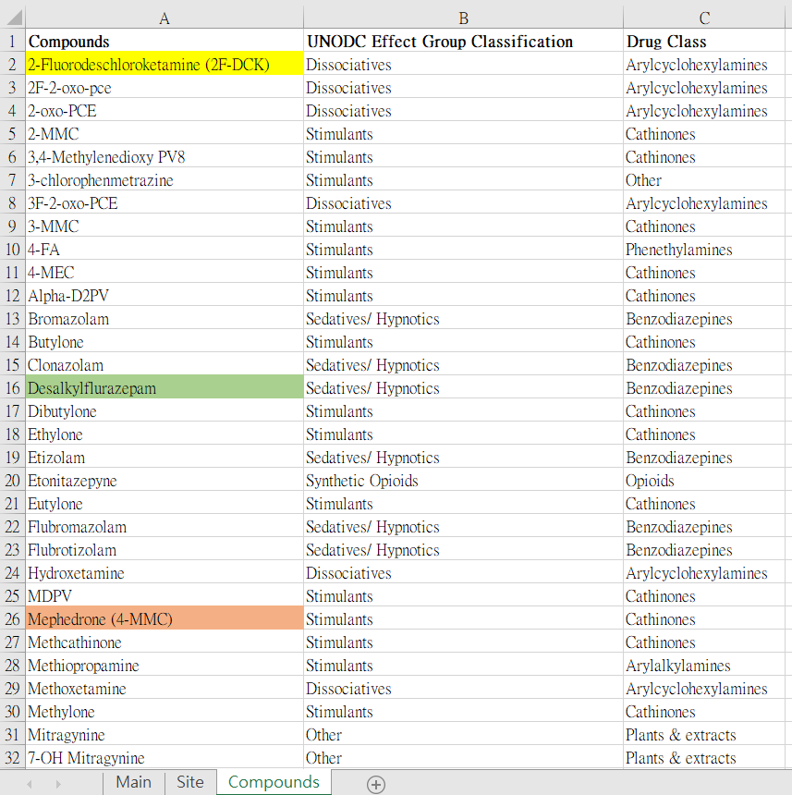
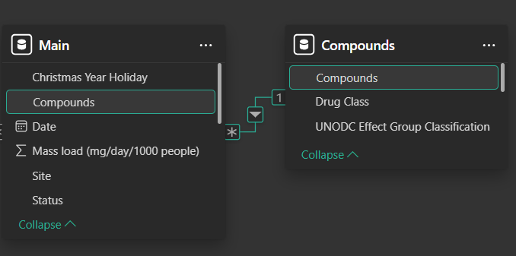
Data Spreadsheet (Compounds)
Containing the Class information of the compounds in main sheet
Linked to the compounds attribute in main sheet

Slide 20
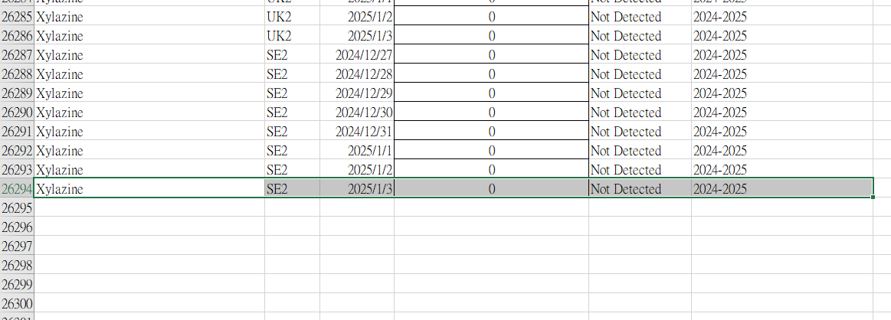
Insert a new record
Typing a new record based on the attribute format
Remember to apply 0 in Mass load if status is Detected but not quantified or Not detected

Slide 21
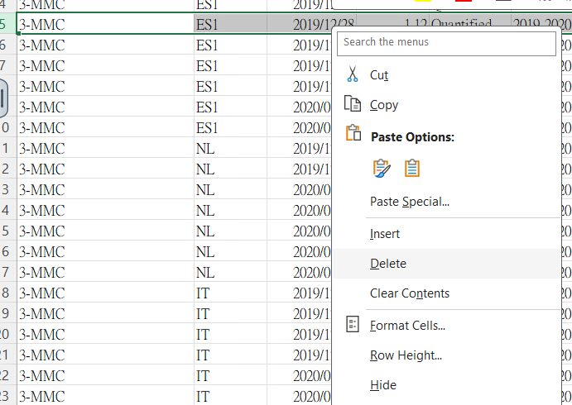
Delete the unwanted record
Delete the entire row without leaving blank or will cause data fetching problem

Slide 22
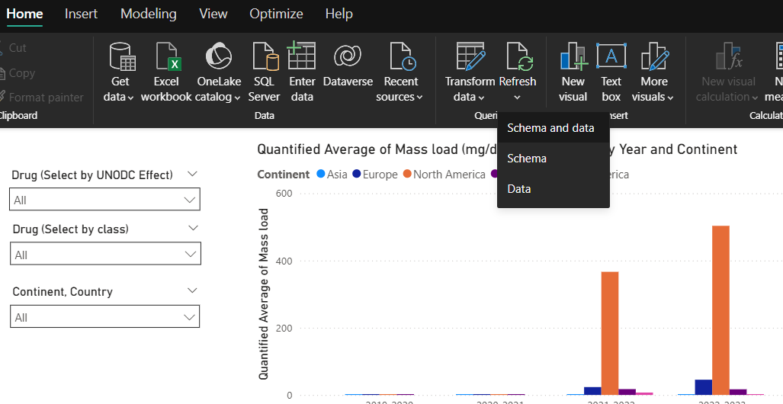
Update data
Once the data is updated, click refresh the schema and data to refresh the dashboard

Slide 23
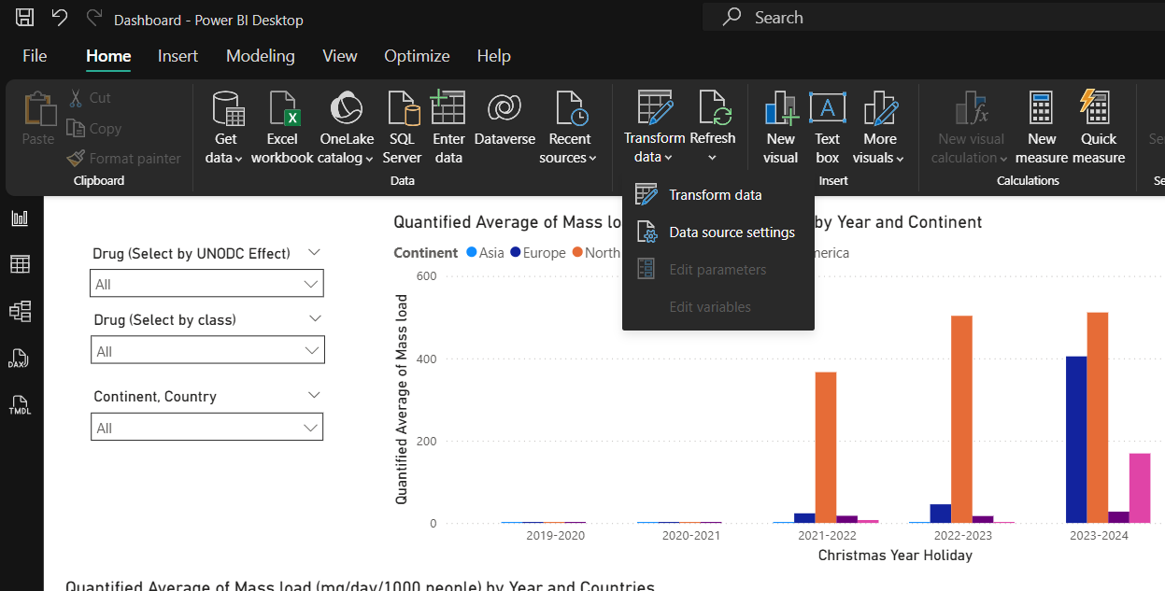
Data source setting
If the spreadsheet file path has changed, click the data source settings in transform data to reset

Slide 24
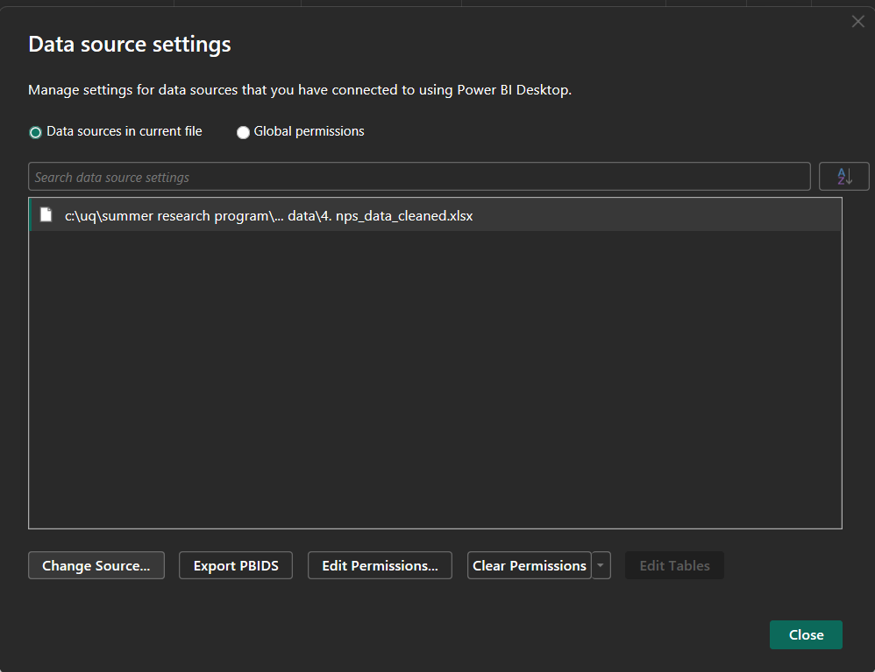
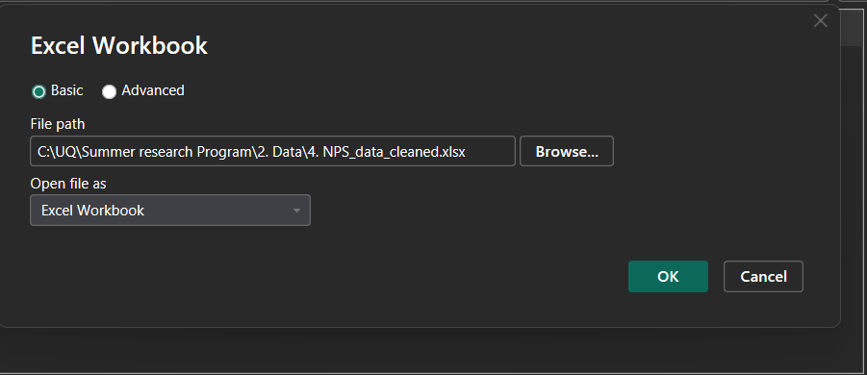
Data source setting
Browse the new file path

Slide 25
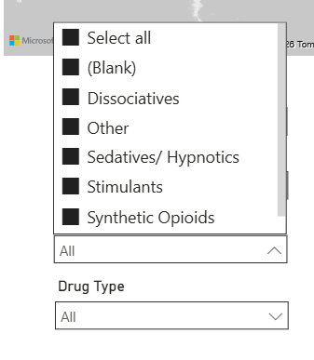
Beware
If there is (Blank) appears in the data slicer after update the spreadsheet, check whether
There is blank in main sheet or
There are new compounds or sites upload in main sheet but haven’t added in the site or compound sheet

Slide 26
Publish Dashboard

Slide 27
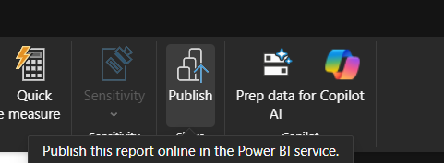
Publish the dashboard
Require Power BI service then upload the files to the workspace
Consult IT services in UQ

